Slide 1

Business Logic, simplified Pitch
Business Logic As A Service

Slide 2
01
BaaS

Slide 3
Introduction
Miradi plc
BaaS
Different,
not typical.
SaaS for business logic.
No Code, Low Code.

Slide 4

Scattered Logic
Big boss. Can you trace, explain, update the business logic of your system, on demand :-
Without checking code ?
Without the vendor ?
While explaining each step in the computation ?
From the comfort of your home or on vacation ?
THE TRUTH: You cannot, yet. Even the implementer is always forced to consult the code !

Slide 5

...solution...
01
02
03
Define business logic without programming knowledge
Let business / analysts manage the business logic using a simple UI
Core system(s) consult business logic via one API

Slide 6
...the need for speed...
E commerce
Micro Finance
Change discount logic before a flash sale goes live in the next few minutes.
Adjust deposit and withdrawal rules instantly for compliance or when anticipating malpractice.
Healthcare
Insurance
Roll out new compliance rules, coverage criteria and rates overnight.
Adjust premium calculation formulas, rates and exclusions in minutes, not weeks.

Slide 7
Business logic As A Service
For Staff
Organization
Tech
Explain the rules.
Justify the calculations.
Update the rules, the steps.
No code.
Own the logic.
Move fast.
React fast.
Be first.
Access the logic via API.
Single point of reference.
Low code.

Slide 8
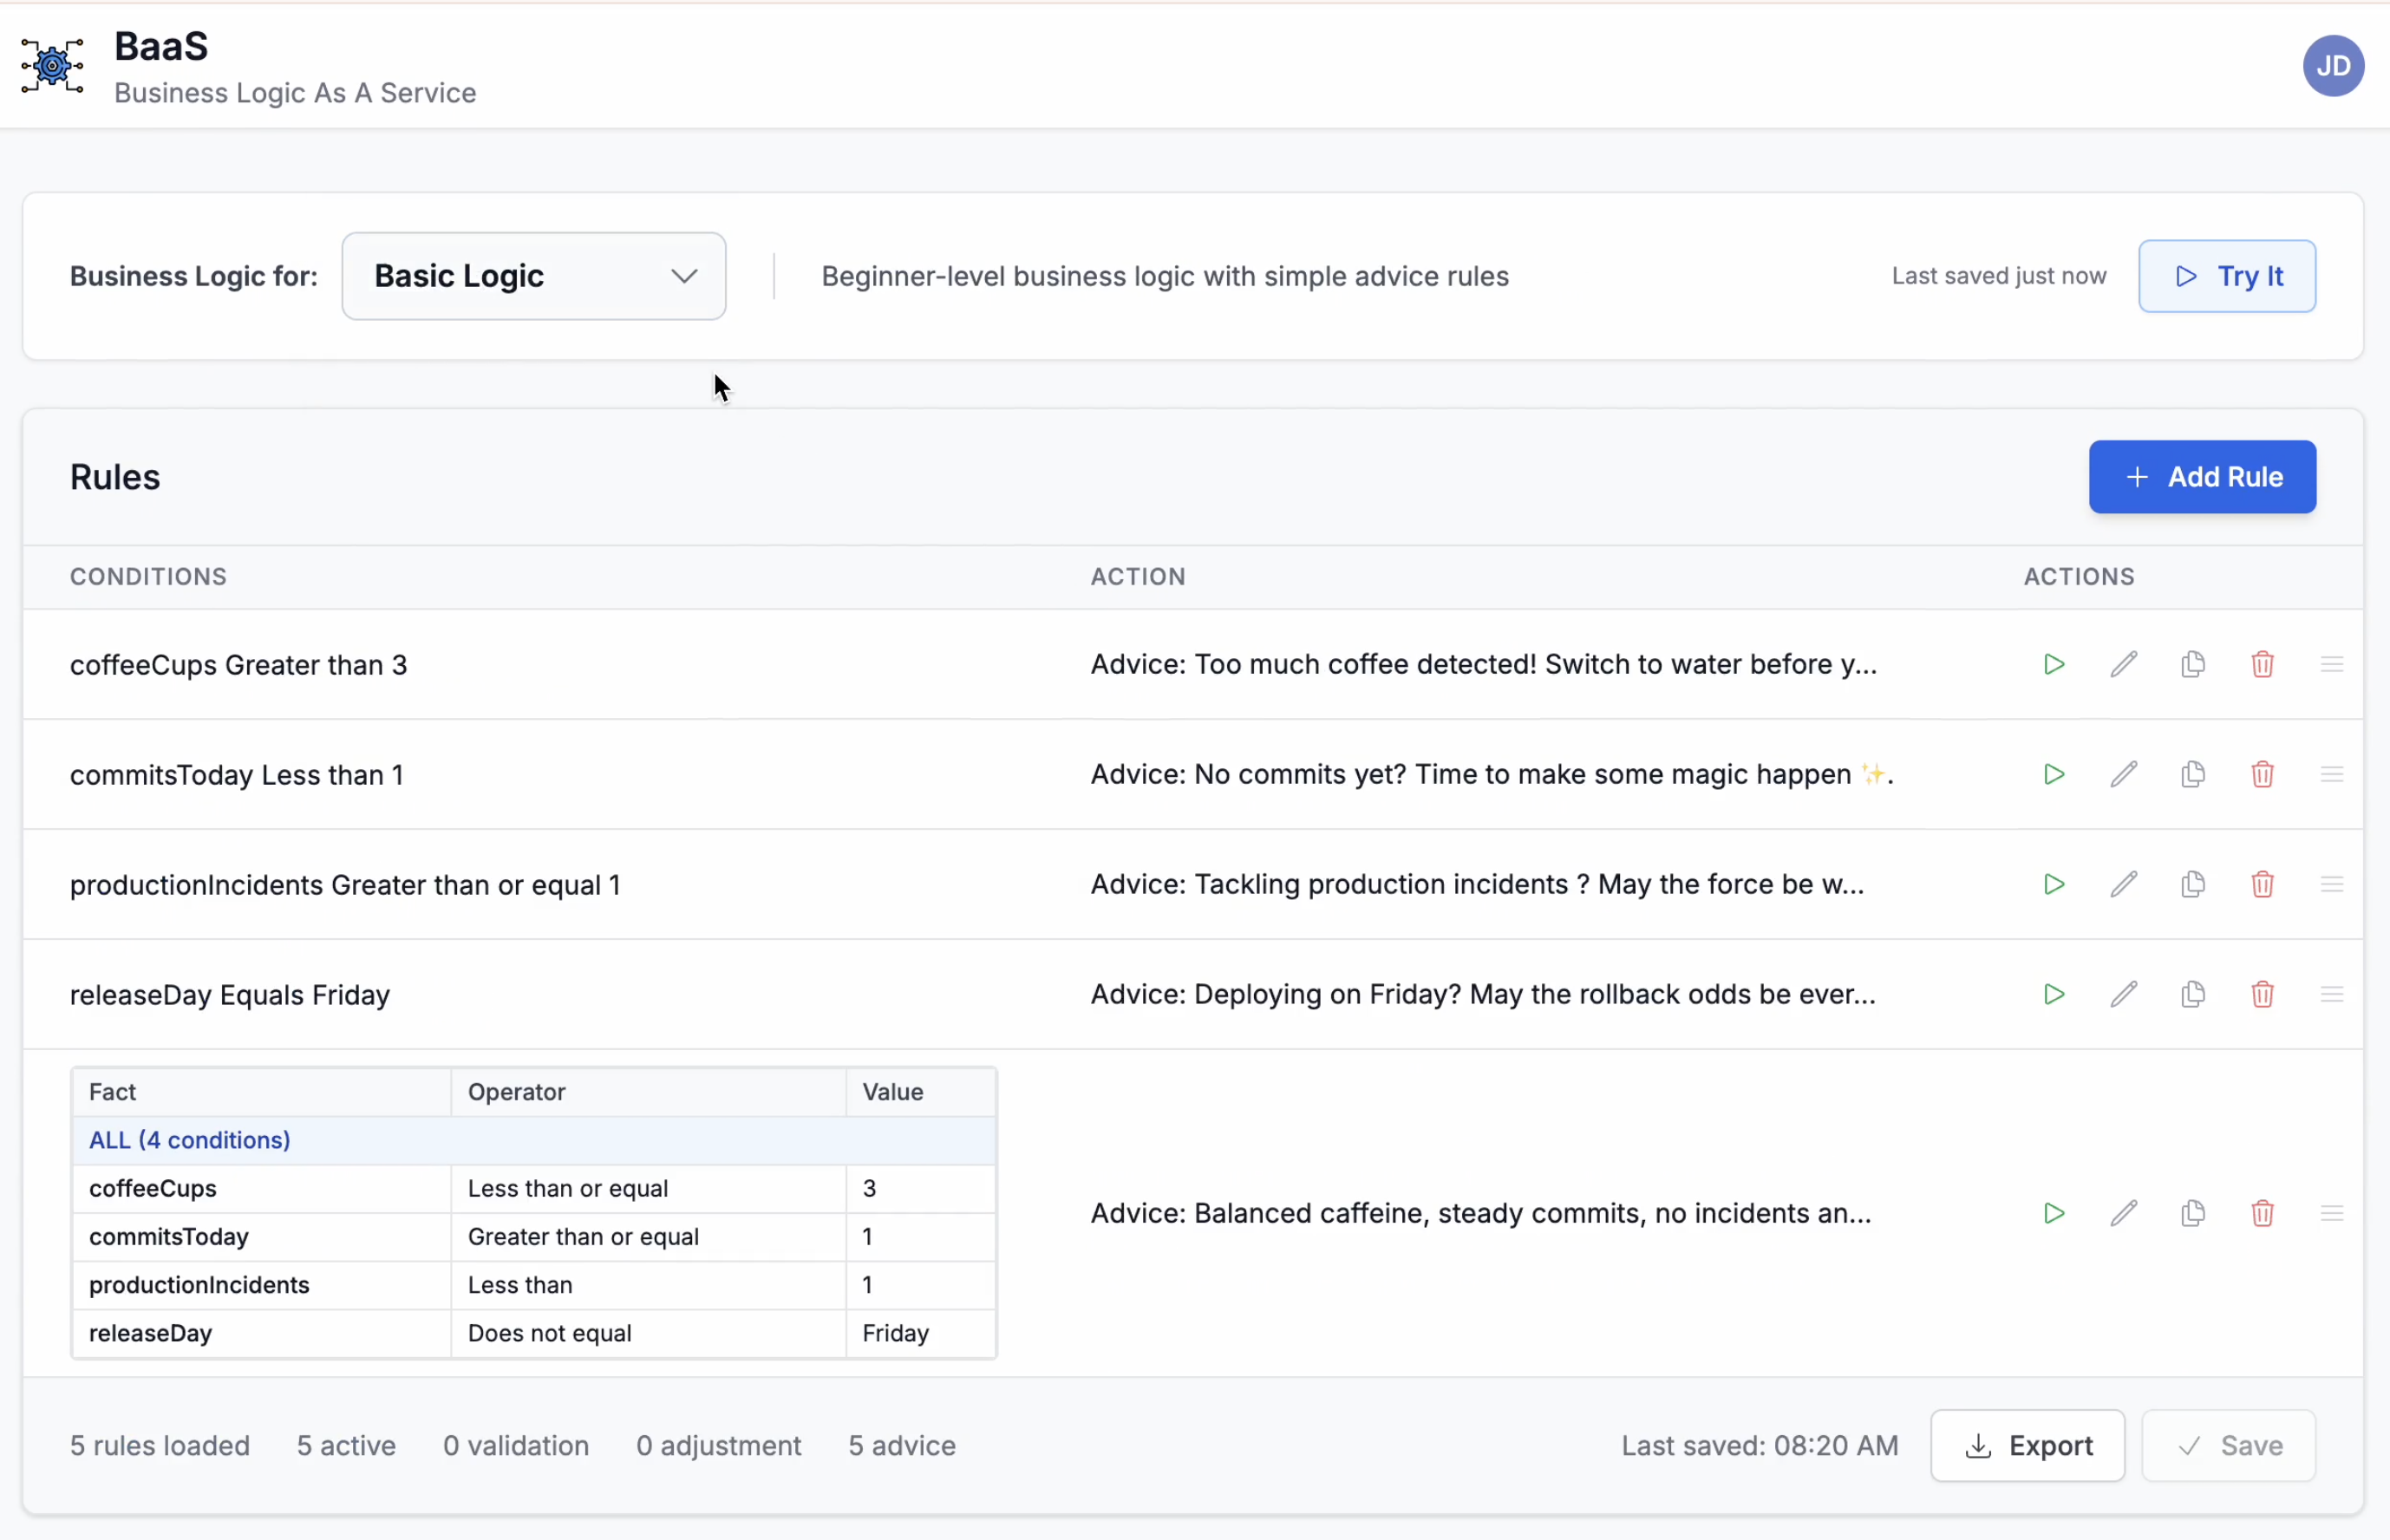
Example 1 - Basic Logic
Features
Simple validation and advice workflows. No code.
Users
Beginners. Try rules and execution sequence.
Value
Understand logic and why each event is triggered.

Slide 9
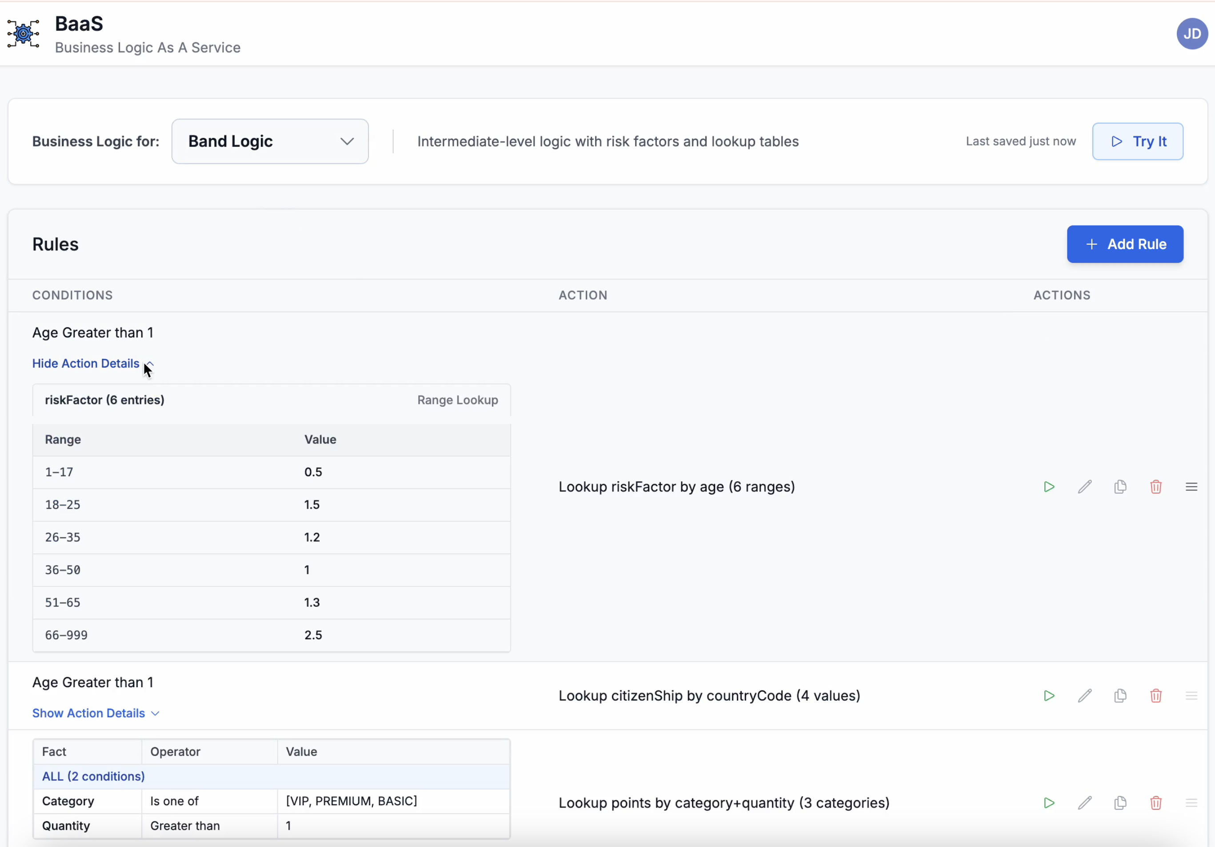
Example 2 - Band Logic
Features
Mix basic and tabular logic. Supports range and value lookups.
Users
Business Analysts, Subject Matter Experts.
Value
Realistic and works for majoritiy of the use cases.

Slide 10
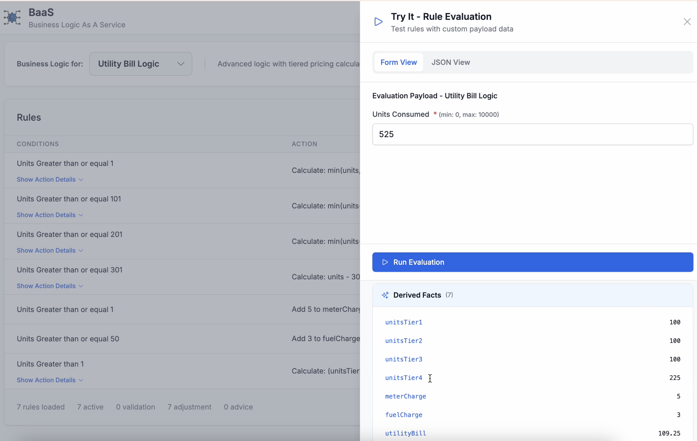
Example 3 - Advanced Logic
Features
Support for common math expressions. Low code
Users
Business Analysts, Tech Support, System Integrators.
Value
Flexibility. Support for highly technical rules.

Slide 11
The Tech
API
REST apis ready out of the box. Support for GraphQL and gRPC currently underway.
Cloud Native
Built for public and private clouds. Works with Docker for on prem installations.
AI
LLM with chat bot to explain and analyse the rules via natural language. Useful for quick references. Ongoing

Slide 12
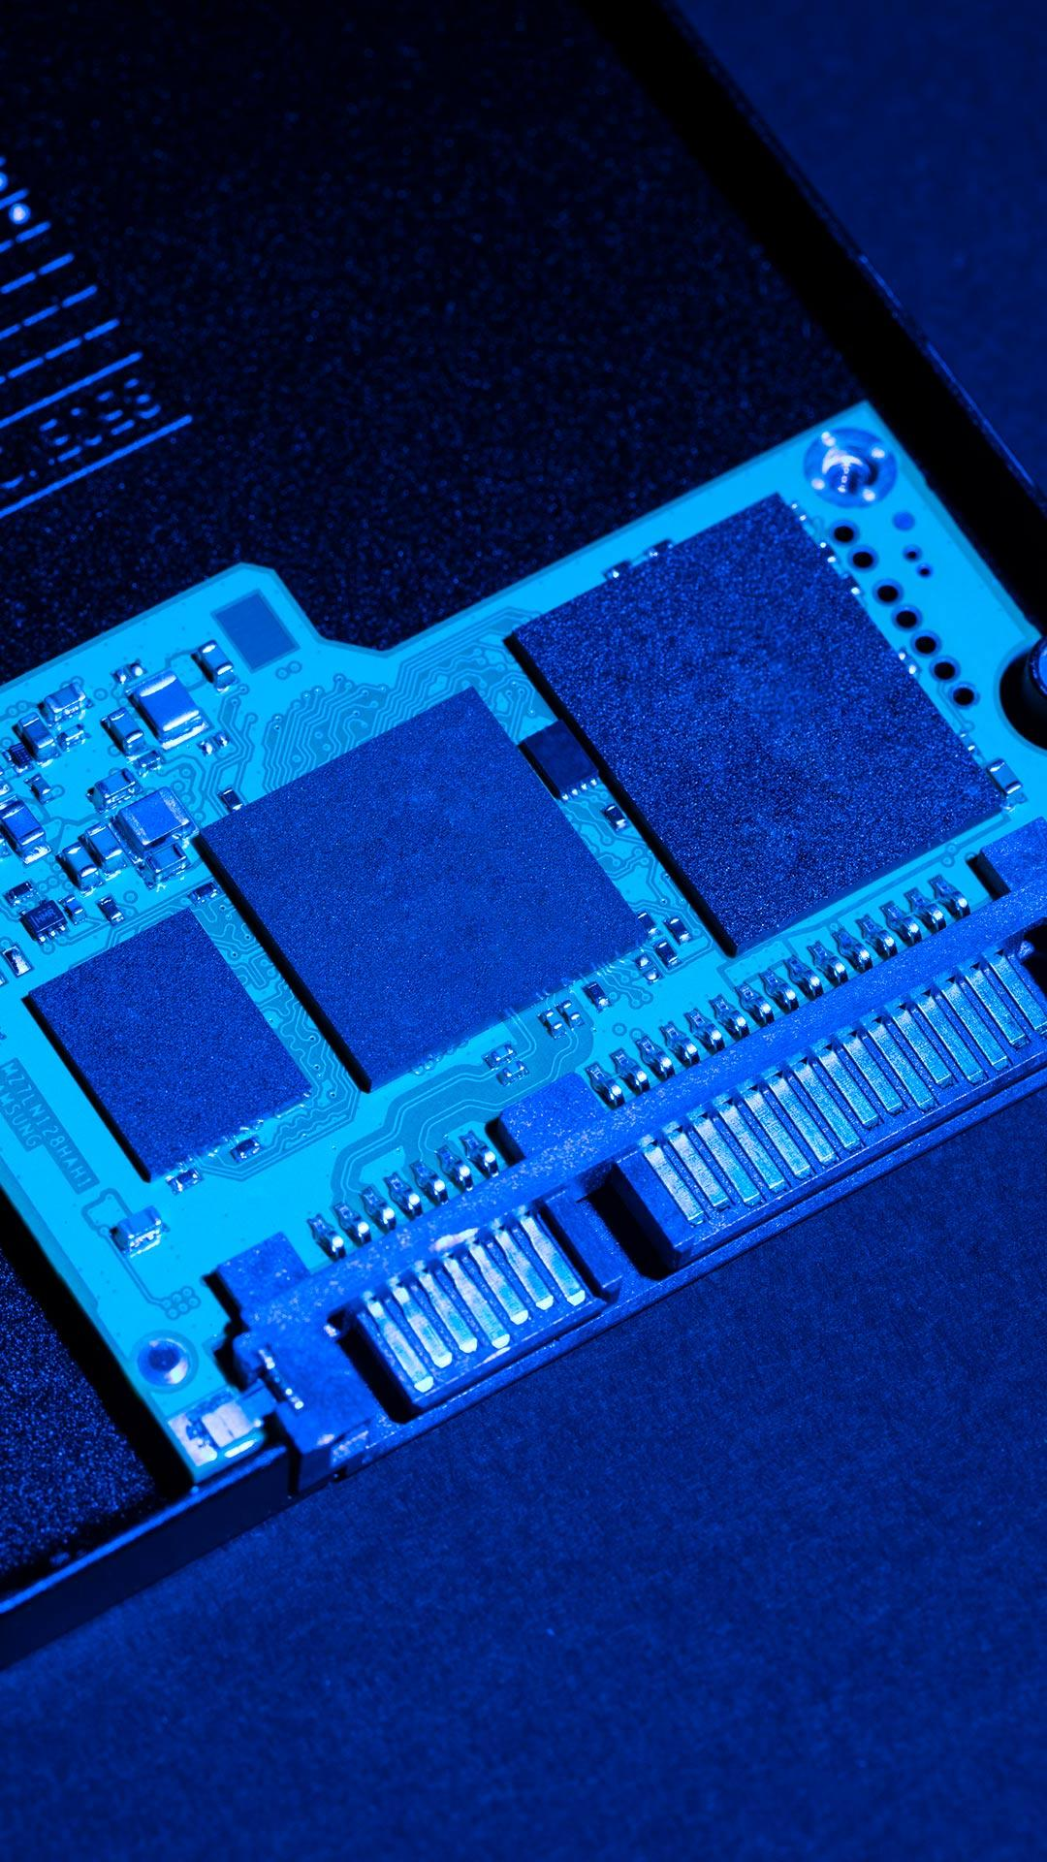
Target Market
Microfinance
E commerce
Saccos
MFIs
Online retailers
Logistics providers
Health care
Insurance
Hospitals
HealthTech
InsureTech
Insurance Companies
Lenders
Tech Providers
Digital Lenders
Banks
Core System vendors
Tech Consultants

Slide 13
On Prem
Higher Privacy, Security.
Subscription
Faster, always up to date.
Freemium
Free tier with limited features.

Slide 14
0$
Early adopters wanted !

Slide 15


Thanks!
Adios
Mabura.zeguru@gmail.com
Phone: on demand
Web: under construction
Please keep this slide for attribution

